Slide 1
Computer Networks Introduction

Slide 2
Course Outcomes
Identify various uses of networks, Design issue of network layers, and summarize its quality-of-service requirements.
Illustrate various routing and congestion control algorithms.
Outline the internet protocol’s structure and demonstrate the working of internet protocols.
Identify transport layer services and show the working of transport layer protocols.
Appraise application layer protocols.
Apply modern networking tools.

Slide 3
Module-1 Introduction(08 hours)
Uses of computer networks: Business Applications, Home Application, Mobile Users, Social Issues; Network hardware: Local Area Networks, Metropolitan Area Networks, Wide Area Networks, Wireless Networks, Home Networks, Internetworks; Network software: Protocol Hierarchies, Design Issues for the Layers, Connection-Oriented and Connectionless Services, Service Primitives. Reference Models: OSI Reference Model and TCP/IP Reference Model.
Chapter 1: 1.1-1.3, 1.4.1, 1.4.2

Slide 4
Computer Networks-definition
A network is a set of devices (often referred to as nodes) connected by communication links. A node can be a computer, printer, or any other device capable of sending and/or receiving data generated by other nodes on the network.
A computer network is a set of computers connected together for the purpose of sharing resources. Ex: Internet.
“Computer Network” to mean a collection of autonomous computers interconnected by a single technology. Two computers are said to be interconnected if they are able to exchange information.
When we communicate, we are sharing information. This sharing can be local or remote.
Local communication between individuals, usually occurs face to face
Remote communication takes place over distance

Slide 5
Factors that affect the Quality
Performance:
Number of users
Type of transmission medium
Hardware
Software
Reliability
Frequency of failure
Recovery time of a network after a failure.
Security
Unauthorized access
Viruses

Slide 6
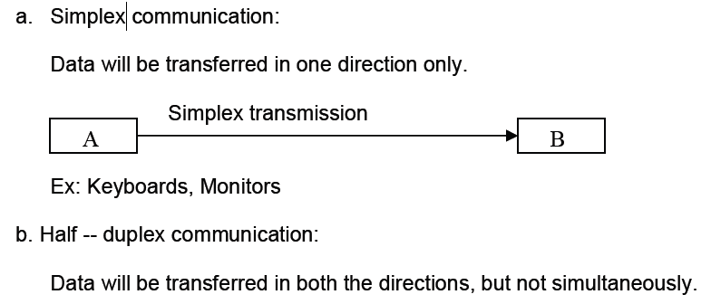
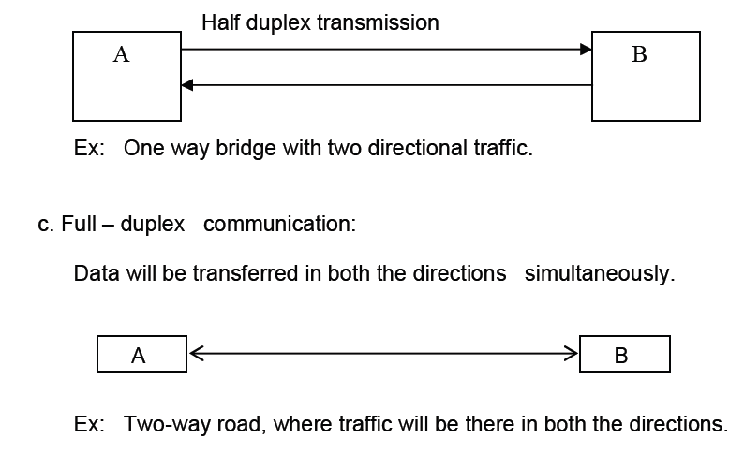
Data transfer methods

Slide 7
Components
A data communications system has five components.

Slide 8
Physical Structures
Type of Connection
Point-to-Point :A point-to-point connection provides a dedicated link between two devices.
Multipoint :A multipoint (also called multi drop) connection is one in which more than two specific devices share a single link.

Slide 9
Physical Topology
The term physical topology refers to the way in which a network is laid out physically.
One or more devices connect to a link; two or more links form a topology.
The topology of a network is the geometric representation of the relationship of all the links and linking devices (usually called nodes) to one another.

Slide 10
Mesh:
In a mesh topology, every device has a dedicated point-to-point link to every other device. The term dedicated means that the link carries traffic only between the two devices it connects

Slide 11
Star Topology:
In a star topology, each device has a dedicated point-to-point link only to a central controller, usually called a hub.

Slide 12
Bus Topology:
A bus topology, on the other hand, is multipoint. One long cable acts as a backbone to link all the devices in a network

Slide 13
Ring Topology:
In a ring topology, each device has a dedicated point-to-point connection with only the two devices on either side of it.

Slide 14
Uses of computer Networks
Business Applications
The aim of networking is to make all programs, equipment’s, and data available to anyone on the network
Each computer has worked in isolation from the others, but at some point they are connected to extract and correlate information about the entire company.
Networks called VPNs (Virtual Private Networks) may be used to join the individual networks at different sites into one extended network.
Client server
Telephone calls between employees may be carried by the computer is called IP telephony or Voice over IP (VoIP) when Internet technology is used
Desktop Sharing is remote workers see and interact with a graphical computer screen.

Slide 15
Resource sharing:
Printers, databases, large storage.
Remote access:
Employees work from home or branch offices.
Client–Server Model:
Clients request services, servers provide them.
Examples: web servers, file servers.
Communication improvements:
Email, collaborative editing, videoconferencing.
E-commerce:
Direct links with suppliers and customers.

Slide 16
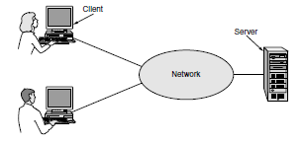
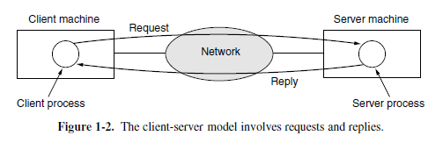
Client Server

Slide 17
Home Applications
The main usage of networks in home is internet. Internet access provides home users with connectivity to remote computers.
Access to remote information Ex: www
Person-to-person communication Ex: chating
Instant Message Ex: Twitter
Social Networking Ex: Face Book, Whatsup
Wikipedia
Interactive entertainment Ex: IPTV
Electronic commerce Ex: shopping
ubiquitous computing, in which computing is embedded into everyday life

Slide 18
Internet services:
Information access, entertainment, online shopping.
Communication:
Email, instant messaging, chat rooms.
Peer-to-peer sharing.
Interactive entertainment:
Online games, streaming video/music.
E-commerce:
Online banking, shopping, auctions.
Learning at home:
Telelearning, e-books, digital libraries.

Slide 19
Mobile Users
Mobile computers, such as notebook computers and personal digital assistants (PDAs) are connected to the office or home even when away from home.
People on the road use their portable electronic equipment to send and receive telephone calls, faxes, and electronic mail, surf the Web, access remote files, and log on to remote machines.
Mobile computing benefits:
Work from anywhere: access calls, emails, documents.
Wireless networking uses:
University campuses, taxis, conferences, military.
Fixed wireless for areas without cables, Wireless hotspots
Everyday smart uses:
Parking meters, vending machines, utility meters.
M-commerce:
Mobile payments, location-based offers.
Wearable devices:
Smartwatches, health monitors, smart dust, pacemakers

Slide 20
Social Issues
Content regulation:
Offensive or politically sensitive material → censorship debates.
Different countries have conflicting laws.
Privacy vs. surveillance:
Governments monitoring emails (e.g., Carnivore/DCS1000).
Companies tracking users via cookies.
Rights conflicts:
Employer vs. employee privacy.
Anonymous communication: whistleblowing vs. legal rights.

Slide 21
Cybercrime & misuse:
Spam, viruses, identity theft.
Copyright violations (music, videos).
Information quality:
Not all online info is accurate.
Security gaps:
Lack of encryption/authentication.
Buggy software adds vulnerabilities.
Future outlook:
Networks will keep growing in scope and uses.
Potential in telemedicine, telelearning, and everyday smart devices.

Slide 22
Network Hardware
LAN
MAN
WAN
Wireless network
Home network
Internetwork

Slide 23
Network Hardware
Local Area Networks
Local area networks, called LANs, are privately-owned networks within a single building or campus of up to a few kilometers in size.
They are widely used to connect personal computers and workstations in company offices and factories
LANs are distinguished by three characteristics: (1) size, (2) transmission technology (3) topology.
LANs are restricted in size. LANs use a transmission technology consisting of a cable to which all the machines are attached. Various topologies are used for broadcast LANs.

Slide 24
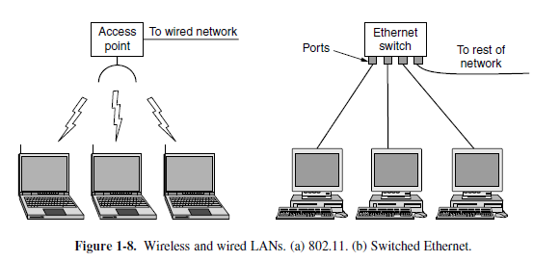

Slide 25
In a bus network, at any instant at most one machine is the master and is allowed to transmit. All other machines are required to refrain from sending.
Eg: IEEE 802.3(Ethernet).
In the ring system each bit propagates around on its own, not waiting for the rest of the packet to which it belongs.
Eg: IEEE 802.5 (the IBM token ring).

Slide 26
Metropolitan Area Networks
Covers a city; larger than a LAN but smaller than a WAN.
Example: Cable television networks in many cities.
Originated from community antenna systems in areas with poor TV reception.
Initially ad hoc, later city-wide systems contracted by governments.
Evolved from TV-only service to also offering specialized channels (news, sports, cooking, etc.).
Upgraded to provide two-way Internet service using unused parts of the cable spectrum.

Slide 27
Wide Area Networks
A wide area network, or WAN, covers large geographical area, often a country or continent.
The hosts are connected by a communication subnet. The job of the subnet is to carry messages from host to host.
In most wide area networks, the subnet consists of two distinct components: transmission lines and switching elements.
Transmission lines move bits between machines.
Switching elements are specialized computers that connect three or more transmission lines.
Designed for high-latency, large-scale data transfer.
Examples: Internet, global corporate networks.

Slide 28
When a packet is sent from one router to another via one or more intermediate routers, the packet is received at each intermediate router in its entirety, stored there until the required output line is free, and then forwarded. This is called store-and-forward or packet-switched subnet.
If the packets are small and all the same size, they are called cells.

Slide 29
Wireless Networks
Wireless networks can be divided into three main categories:
1. System interconnection. 2. Wireless LANs. 3. Wireless WANs.
System interconnection is all about interconnecting the components of a computer using short-range radio. EX: short-range radio wireless networks called Bluetooth
Transmits data using radio waves instead of cables, removing the need for physical wiring.
Enables mobility, allowing users to connect and move devices freely within coverage.
Includes technologies like Wi-Fi, Bluetooth, and cellular mobile networks.
Can be quickly expanded without installing new cables or network lines.
Speed and range vary depending on the wireless standard and frequency used.
Example: Wi-Fi networks in airports, offices, cafes, and public hotspots.

Slide 30
Home Networks
Computers (desktop PC). Entertainment (TV, DVD). Telecommunications (telephone, mobile telephone). Appliances (microwave, refrigerator). Telemetry (utility meter, smoke/burglar alarm).
Connects multiple household devices like computers, entertainment systems, appliances, and security equipment.
Allows devices to communicate with each other and access the Internet from anywhere in the home.
Must be easy to install and operate, as most users are non-technical and expect reliability from day one.
Needs high performance for multimedia streaming, remote monitoring, and interactive applications.
Should be affordable, expandable, and based on stable interfaces to avoid frequent upgrades.
Security and reliability are critical to prevent unauthorized access and protect connected devices.

Slide 31
Internetwork
Combination of two or more networks such as LAN, MAN, and WAN, allowing them to function as one system.
Facilitates communication and resource sharing between devices on different networks.
Uses routers, gateways, and switches to connect and manage traffic between networks.
Supports both similar and different network technologies for seamless integration.
Can be private (intranet) for internal use or public (Internet) for global access.
Example: Corporate offices worldwide connected via Internet for collaboration.

Slide 32
Network software
Protocol Hierarchies
The first computer networks were hardware-focused, with software as an afterthought a strategy that no longer works.
Modern network software is highly structured, forming a key concept in networking.
Most networks are organized as a stack of layers, each built upon the one below it.
Each layer offers services to higher layers, hiding implementation details, acting like a virtual machine.
This concept is similar to information hiding, abstract data types, data encapsulation, and object-oriented programming.
Layer n communicates with layer n on another machine using agreed rules called the layer n protocol. a protocol is an agreement between the communicating parties on how communication is to proceed.

Slide 33
The entities in corresponding layers on different machines are called peers, which may be processes, devices, or even humans.
In reality, no data are directly transferred from layer n on one machine to layer n on another machine.
Each layer passes data and control information to the layer immediately below it until the lowest layer is reached.
Below layer 1 is the physical medium through which actual communication occurs.
Virtual communication is shown by dotted lines and physical communication by solid lines.

Slide 34
Between each pair of adjacent layers is an interface defining primitive operations and services available to the upper layer.
Clean interfaces require each layer to perform a specific set of well-understood functions and allow replacing the implementation of one layer with a different one without affecting higher layers.
A set of layers and protocols is called a network architecture, with enough information for correct implementation.
A list of protocols used by a system, one per layer, is called a protocol stack.

Slide 35
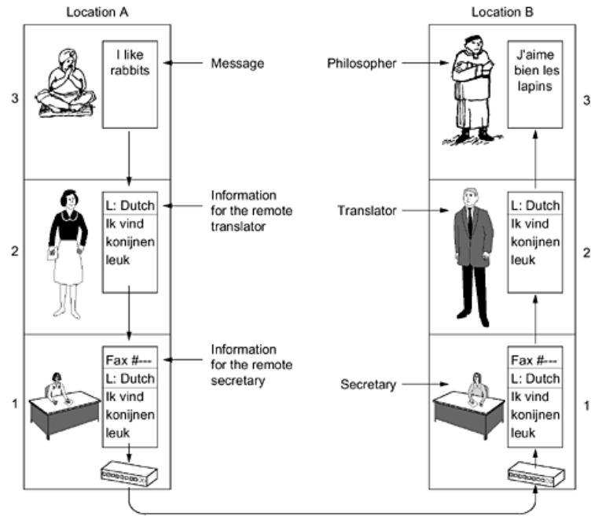

Slide 37
Design Issues for the Layers
1. Addressing
Every layer needs a mechanism for identifying senders and receivers.
A process on one machine must specify with whom it wants to talk, requiring some form of addressing.
2. Data Transfer Rules
Some systems allow data only in one direction, while others allow two-way communication.
The protocol must determine how many logical channels a connection has and their priorities.
3. Error Control
Physical communication circuits are imperfect, so error-detecting or error-correcting codes are needed.
Both ends of the connection must agree on which error control method is used.
4. Sequencing
Not all channels preserve the order of messages, so protocols must handle proper reassembly.
Numbering pieces helps, but handling out-of-order arrivals is still required.

Slide 38
5. Flow Control
Prevents a fast sender from swamping a slow receiver with data.
Solutions include feedback from receiver to sender or limiting the sender’s transmission rate.
6. Message Size Handling
Long messages must be disassembled, transmitted, and reassembled.
Small messages can be combined into a single larger one for efficiency.
7. Multiplexing
The same connection may carry multiple unrelated conversations.
Multiplexing and demultiplexing should be transparent to the layers above.
8. Routing
When multiple paths exist, a route must be chosen between source and destination.
Routing decisions can be split between high-level policy and low-level traffic-based choices.
9. Channel Priorities
Many networks provide separate channels for normal and urgent data.
This allows urgent information to be transmitted without waiting for normal data.

Slide 39
Connection-Oriented and Connectionless Services
Layers can offer two types of service
Connection-oriented and connectionless.
Connection-oriented service is like the telephone system:
establish connection → use connection → release connection.
In connection-oriented service, the connection acts like a tube, bits go in at one end and come out at the other, usually in order.
Sometimes, a connection setup includes negotiation on parameters like maximum message size or quality of service.
Connectionless service is like the postal system, each message carries the full destination address and is routed independently.
In connectionless service, messages usually arrive in order, but delays can cause out-of-order delivery.

Slide 40
Quality of service can vary — reliable services never lose data, using acknowledgements for confirmation.
Reliable services introduce overhead and delay, but are often worth it; sometimes, however, delays are undesirable.
Example:
File transfer needs reliable connection-oriented service to ensure correct and ordered delivery of all bits.
Remote login (SSH, Telnet) needs every keystroke must arrive correctly, otherwise commands fail.
digitized voice or video conferencing, prefer speed over reliability to avoid delays from acknowledgements.
junk email, only need a single message sent without setting up a connection — unreliable connectionless service (datagram service).
Acknowledged datagram service provides connectionless transmission but with delivery confirmation (like registered mail with return receipt).
Request-reply service sends one datagram as a request and receives a reply with the answer.

Slide 42
Service Primitives

Slide 43
The server executes LISTEN to indicate that it is prepared to accept incoming connections. server process is blocked until a request for connection appears.
The client process executes CONNECT to establish a connection with the server. The CONNECT call needs to specify who to connect to.
When the system sees that the packet is requesting a connection, it checks to see if there is a listener.
it does two things: unblocks the listener and sends back an acknowledgement. The arrival of this acknowledgement then releases the client.
The server executes RECEIVE to prepare to accept the first request. Then the client executes SEND to transmit its request followed by the execution of RECEIVE to get the reply.
The client use DISCONNECT to terminate the connection. When the server gets the packet, it also issues a DISCONNECT of its own, acknowledging the client and releasing the connection.

Slide 44
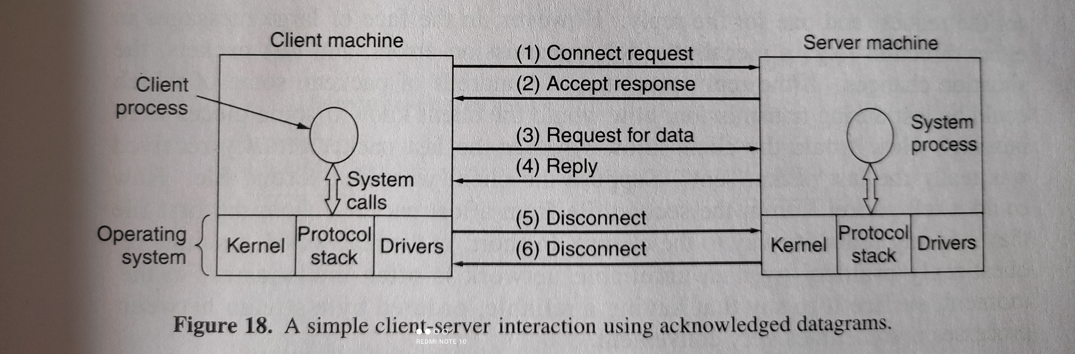

Slide 45
Reference Models
two important network architectures, the OSI reference model and the TCP/IP reference model.
Although the protocols associated with the OSI model are rarely used any more, the model itself is actually quite general and still valid, and the features discussed at each layer are still very important.
The TCP/IP model has the opposite properties: the model itself is not of much use but the protocols are widely used.

Slide 46
OSI(open system interconnection) Model
This model is based on a proposal developed by the International Standards Organization (ISO) as a first step toward international standardization of the protocols used in the various layers (Day and Zimmermann, 1983).
It was revised in 1995 (Day, 1995). The model is called the ISO OSI (Open Systems Interconnection) Reference Model because it deals with connecting open systems—that is, systems that are open for communication with other systems

Slide 47
The OSI model has seven layers.
The principles that were applied to arrive at the seven layers can be briefly summarized as follows:
1. A layer should be created where a different abstraction is needed.
2. Each layer should perform a well-defined function.
3. The function of each layer should be chosen with an eye toward defining internationally standardized protocols.
4. The layer boundaries should be chosen to minimize the information flow across the interfaces.
5. The number of layers should be large enough that distinct functions need not be thrown together in the same layer out of necessity and small enough that the architecture does not become unwieldy.

Slide 49
Physical Layer – Layer 1
It is responsible for the actual physical connection between the devices.
The physical layer contains information in the form of bits.
When receiving data, this layer will get the signal received and convert it into 0s and 1s and send them to the Data Link layer
Hub, Repeater, Modem, and Cables are Physical Layer devices.

Slide 50
Functions of the Physical Layer
Bit synchronization: The physical layer provides the synchronization of the bits
Bit rate control: The Physical layer also defines the transmission rate i.e. the number of bits sent per second.
Physical topologies: Physical layer specifies how the different, devices/nodes are arranged in a network i.e. bus, star, or mesh topology.
Transmission mode: Physical layer also defines how the data flows between the two connected devices. The various transmission modes possible are Simplex, half-duplex and full-duplex.

Slide 51
Data Link Layer (DLL) – Layer 2
The data link layer is responsible for the node-to-node delivery of the message.
The main function of this layer is to make sure data transfer is error-free from one node to another, over the physical layer.
When a packet arrives in a network, it is the responsibility of the DLL to transmit it to the Host using its MAC address.
The packet received from the Network layer is further divided into frames depending on the frame size .
DLL also encapsulates Sender and Receiver’s MAC address in the header.
Switch & Bridge are Data Link Layer devices. Packet in the Data Link layer is referred to as Frame.

Slide 52
Functions of the Data Link Layer
Framing: Framing is a function of the data link layer. It provides a way for a sender to transmit a set of bits that are meaningful to the receiver.
Physical addressing: After creating frames, the Data link layer adds physical addresses (MAC addresses) of the sender and/or receiver in the header of each frame.
Error control: The data link layer provides the mechanism of error control in which it detects and retransmits damaged or lost frames.
Flow Control: flow control coordinates the amount of data that can be sent before receiving an acknowledgment.
Access control: MAC sub-layer of the data link layer helps to determine which device has control over the channel at a given time.

Slide 53
Network Layer – Layer 3
The network layer works for the transmission of data from one host to the other located in different networks.
It also takes care of packet routing
The sender & receiver’s IP addresses are placed in the header by the network layer.

Slide 54
Functions of the Network Layer
Routing: The network layer protocols determine which route is suitable from source to destination.
Logical Addressing: To identify each device on Internet work uniquely, the network layer defines an addressing scheme. The sender & receiver’s IP addresses are placed in the header by the network layer.
Segment in the Network layer is referred to as Packet.
Network layer is implemented by networking devices such as routers and switches.

Slide 55
Transport Layer – Layer 4
The transport layer provides services to the application layer and takes services from the network layer.
It is responsible for the End to End Delivery of the complete message.
The transport layer also provides the acknowledgment of the successful data transmission and re-transmits the data if an error is found
Data in the Transport Layer is called Segments.
The transport layer is called as Heart of the OSI model.
Device or Protocol Use : TCP, UDP

Slide 56
At the sender’s side:
The transport layer receives the formatted data from the upper layers, performs Segmentation, and also implements Flow & Error control to ensure proper data transmission.
It also adds Source and Destination port numbers in its header and forwards the segmented data to the Network Layer.
At the receiver’s side:
Transport Layer reads the port number from its header and forwards the Data which it has received to the respective application.
It also performs sequencing and reassembling of the segmented data.

Slide 57
Functions of the Transport Layer
Segmentation and Reassembly: This layer accepts the message from the session layer, and breaks the message into smaller units. Each of the segments produced has a header associated with it. The transport layer at the destination station reassembles the message.
Service Point Addressing: To deliver the message to the correct process, the transport layer header includes a type of address called service point address or port address.

Slide 58
Services
1. Connection-Oriented Service: It is a three-phase process that includes
Connection Establishment
Data Transfer
Termination/disconnection
2. Connectionless service: It is a one-phase process and includes Data Transfer.
In this type of transmission, the receiver does not acknowledge receipt of a packet.
Connection-oriented service is more reliable than connectionless Service.

Slide 59
Session Layer – Layer 5
This layer is responsible for the establishment of connection, maintenance of sessions, and authentication, and also ensures security
Protocols used: Point-to-Point Tunneling Protocol (PPTP)

Slide 60
Functions of the Session Layer
Session establishment, maintenance, and termination: The layer allows the two processes to establish, use and terminate a connection.
Synchronization: synchronization points help to identify the error so that the data is re-synchronized properly, and ends of the messages are not cut prematurely and data loss is avoided.
Dialog Controller: The session layer allows two systems to start communication with each other in half-duplex or full-duplex

Slide 61
Presentation Layer – Layer 6
The presentation layer is also called the Translation layer.
The data from the application layer is extracted here and manipulated as per the required format to transmit over the network.
Device or Protocol Use : FTP(FileTransfer Protocol)

Slide 62
Functions of the Presentation Layer
Translation: For example, ASCII to EBCDIC(Extended Binary Coded Decimal Interchange Code).
Encryption/ Decryption: Data encryption translates the data into another form or code.
The encrypted data is known as the ciphertext and the decrypted data is known as plain text. A key value is used for encrypting as well as decrypting data.
Compression: Reduces the number of bits that need to be transmitted on the network.

Slide 63
Application Layer – Layer 7
This Application layer is implemented by the network applications.
This layer also serves as a window for the application services to access the network and for displaying the received information to the user.
Device or Protocol Use : SMTP(Simple Mail Transfer Protocol)

Slide 64
Functions of the Application Layer
Network Virtual Terminal: It allows a user to log on to a remote host.
FTAM- File transfer access and management : This application allows a user to access file in a remote host, retrieve files in remote host and manage or control files from a remote computer.
Mail Services : Provide email service.
Directory Services : This application provides distributed database sources and access for global information about various objects and services.

Slide 65
The TCP/IP Reference Model
TCP/IP was designed and developed by the Department of Defense (DoD) in the 1960s and is based on standard protocols.
It stands for Transmission Control Protocol/Internet Protocol.
It contains four layers, unlike the seven layers in the OSI model.
The main work of TCP/IP is to transfer the data of a computer from one device to another.
The Aim is to make data reliable and accurate so that the receiver will receive the same information which is sent by the sender.
To ensure that, each message reaches its final destination accurately, the TCP/IP model divides its data into packets and combines them at the other end.

Slide 67
The Network Interface Layer
Network Access layer defines details of how data is physically sent through the network, including how bits are electrically or optically signaled by hardware devices .
The layer is responsible for placing TCP/IP packets on the network medium and receiving TCP/IP packets off the network medium.
It is used to connect different network types like LAN technologies
The protocols included are Ethernet, Token Ring, FDDI(Fiber Distributed Data Interface), Frame Relay

Slide 68
The Internet Layer
This layer permits hosts to inject packets into any network and have them travel independently to the destination.
It defines an official packet format and protocol called IP (Internet Protocol).
The job of the internet layer is to deliver IP packets where they are supposed to go.
The Internet layer is responsible for addressing, packaging, and routing functions.
The core protocols of the Internet layer are IP, ARP, ICMP, and IGMP.

Slide 69
The Internet Protocol (IP) is a routable protocol responsible for IP addressing, routing, and the fragmentation and reassembly of packets.
The Address Resolution Protocol (ARP) is responsible for the resolution of the Internet layer address to the Network Interface layer address such as a hardware address.
The Internet Control Message Protocol (ICMP) is responsible for providing diagnostic functions and reporting errors due to the unsuccessful delivery of IP packets.
The Internet Group Management Protocol (IGMP) is responsible for the management of IP multicast groups.

Slide 70
The Transport Layer
It is designed to allow peer entities on the source and destination hosts to carry on a conversation.
TCP (Transmission Control Protocol), is a reliable connection-oriented protocol that allows a byte stream originating on one machine to be delivered without error on any other machine in the internet.
It fragments the incoming byte stream into discrete messages and passes each one on to the internet layer.
At the destination, the receiving TCP process reassembles the received messages
UDP (User Datagram Protocol), is an unreliable, connectionless protocol for applications

Slide 72
The Application Layer
The Application layer provides applications/ the ability to access the services of the other layers
The most widely-known Application layer protocols are those used for the exchange of user information:
The Hypertext Transfer Protocol (HTTP) is used to transfer files that make up the Web pages of the World Wide Web.
The File Transfer Protocol (FTP) is used for interactive file transfer.
The Simple Mail Transfer Protocol (SMTP) is used for the transfer of mail messages and attachments.
Telnet, a terminal emulation protocol, is used for logging on remotely to network hosts.

Slide 73
The Domain Name System (DNS) is used to resolve a host name to an IP address.
The Routing Information Protocol (RIP) is a routing protocol that routers use to exchange routing information on an IP internetwork.
The Simple Network Management Protocol (SNMP) is used monitor and manage network devices connected over an IP. SNMP is used for communication between routers, switches, firewalls, servers, CCTV cameras, and wireless devices.

